Slide 1
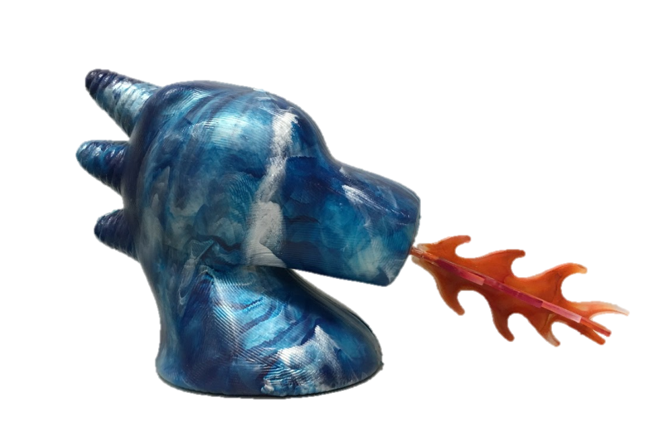
Nora the Dragon
D’Aprile, Eichenlaub, El Shabazz, Hullings

Slide 2
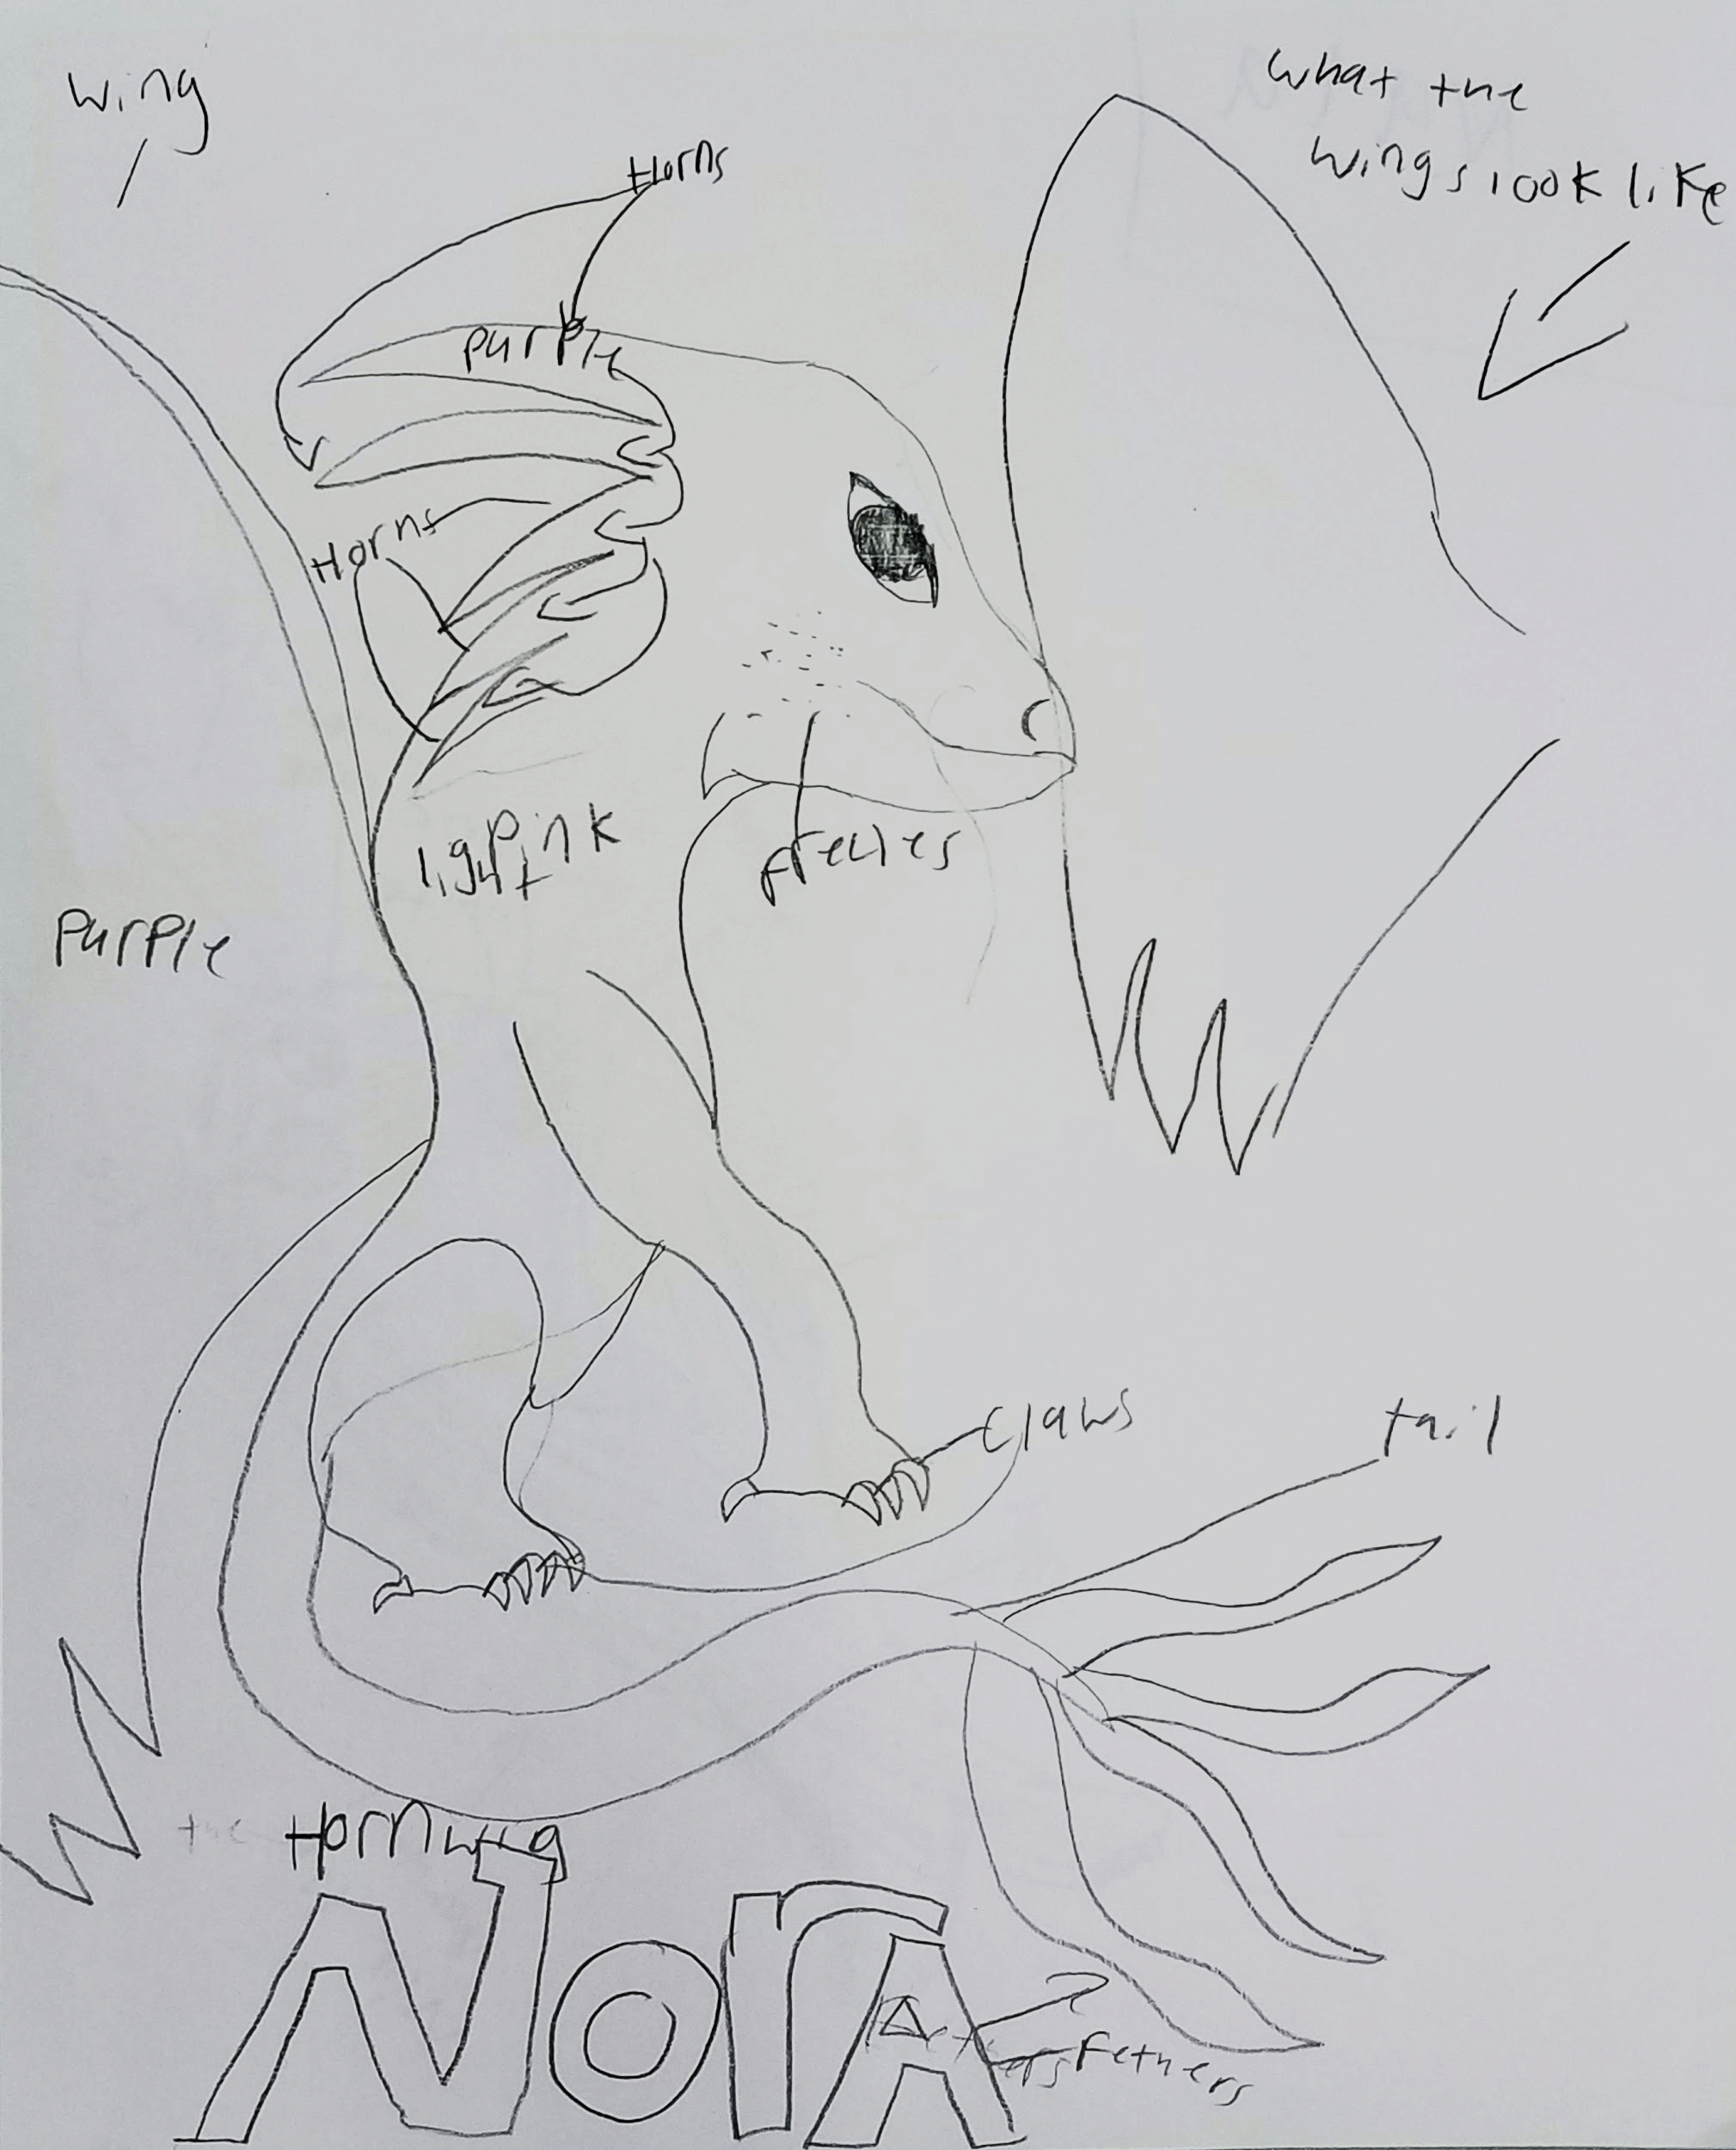
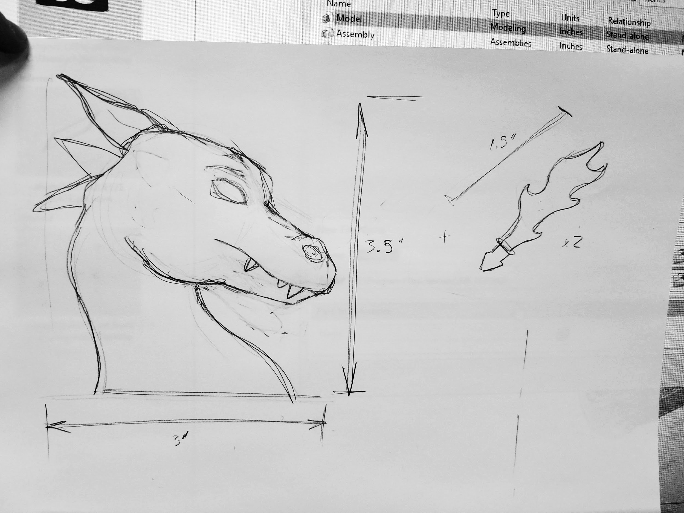
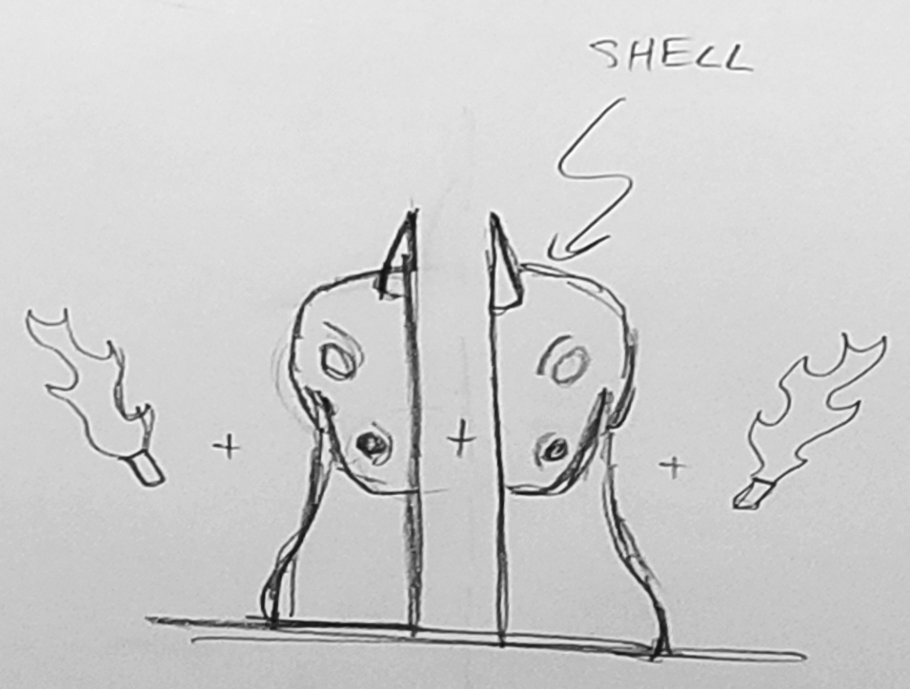
Design - Concept Drawings

Slide 3
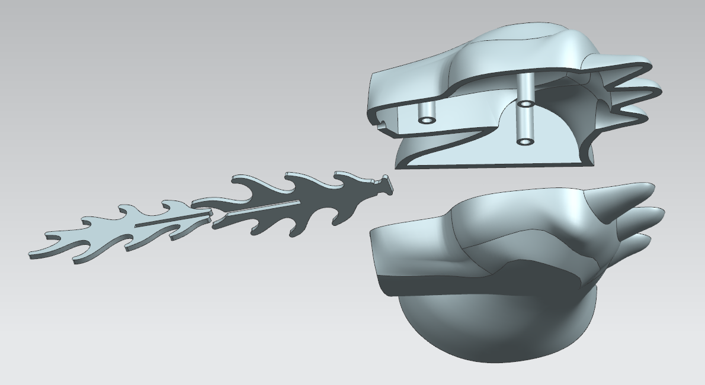
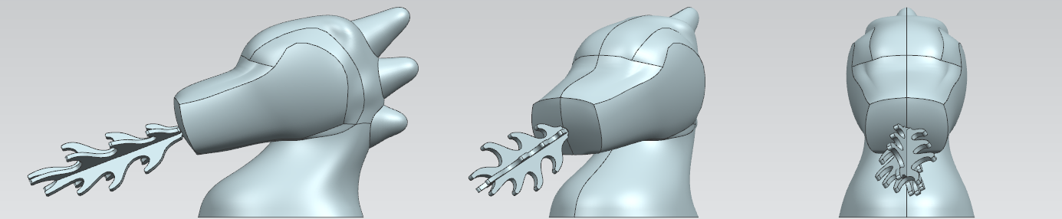
Design - Injection Molding Considerations
Draft at parting surfaces for demolding
No overhangs
Even shell thickness
Minimum cut radius of 1/16”

Slide 4
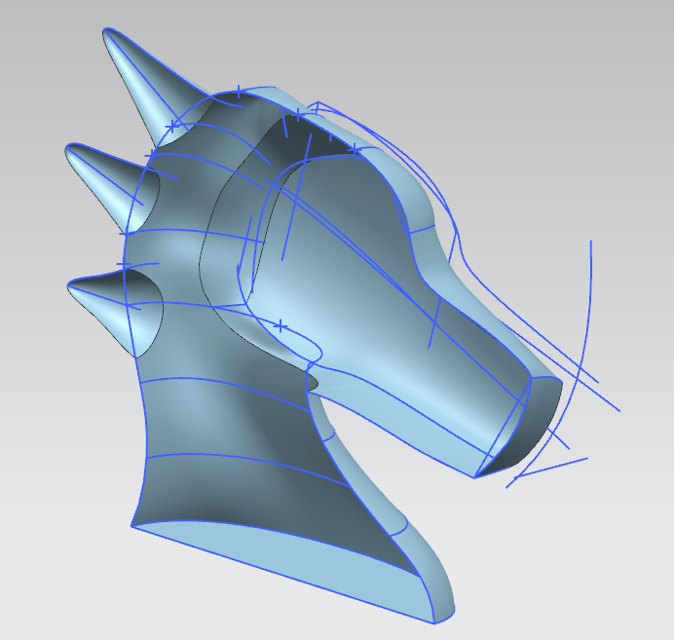
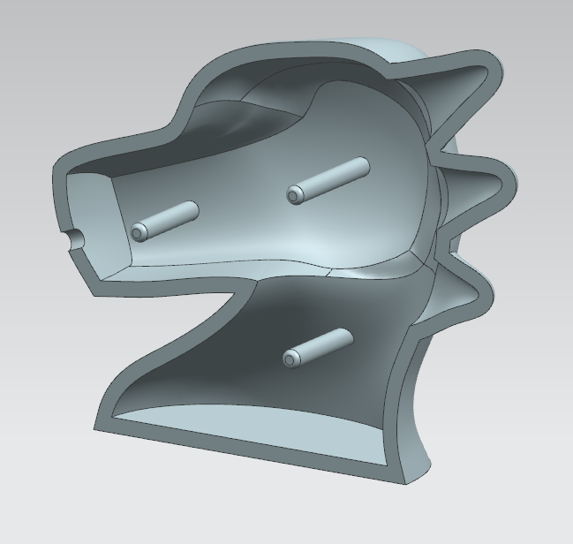
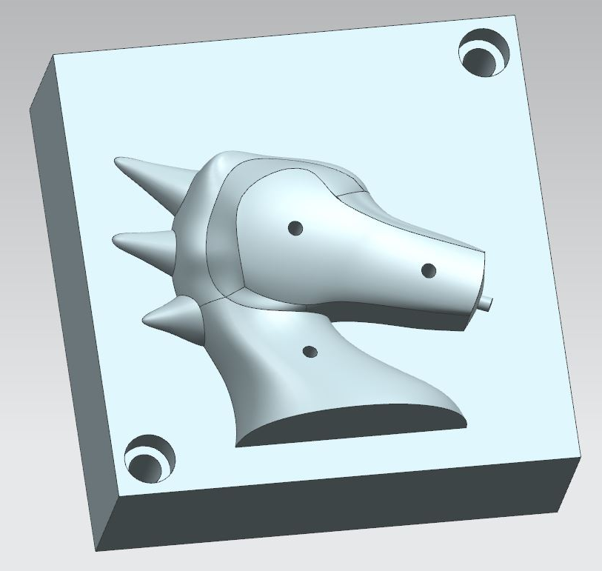
Design - Part and Mold Modeling
Surface modelling in NX
Modelled part and transferred to geometry on mold blanks

Slide 5
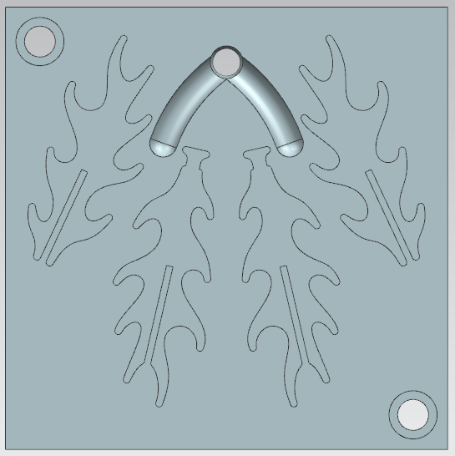
Design - Gates and Runners
Minimize distance
Naturally balanced

Slide 6
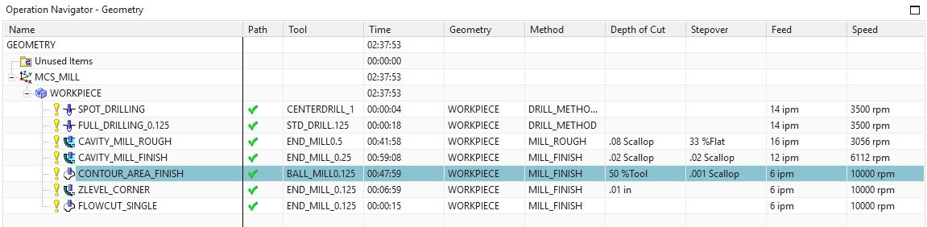
Manufacturing - Toolpaths
Notes:
Screencaps of the manufacturing programs for all 5 files
Explain some choices verbally
Speak on choices of tool path and surface finishes
Time to finish tradeoff

Slide 7

Manufacturing - CAM Simulation

Slide 8
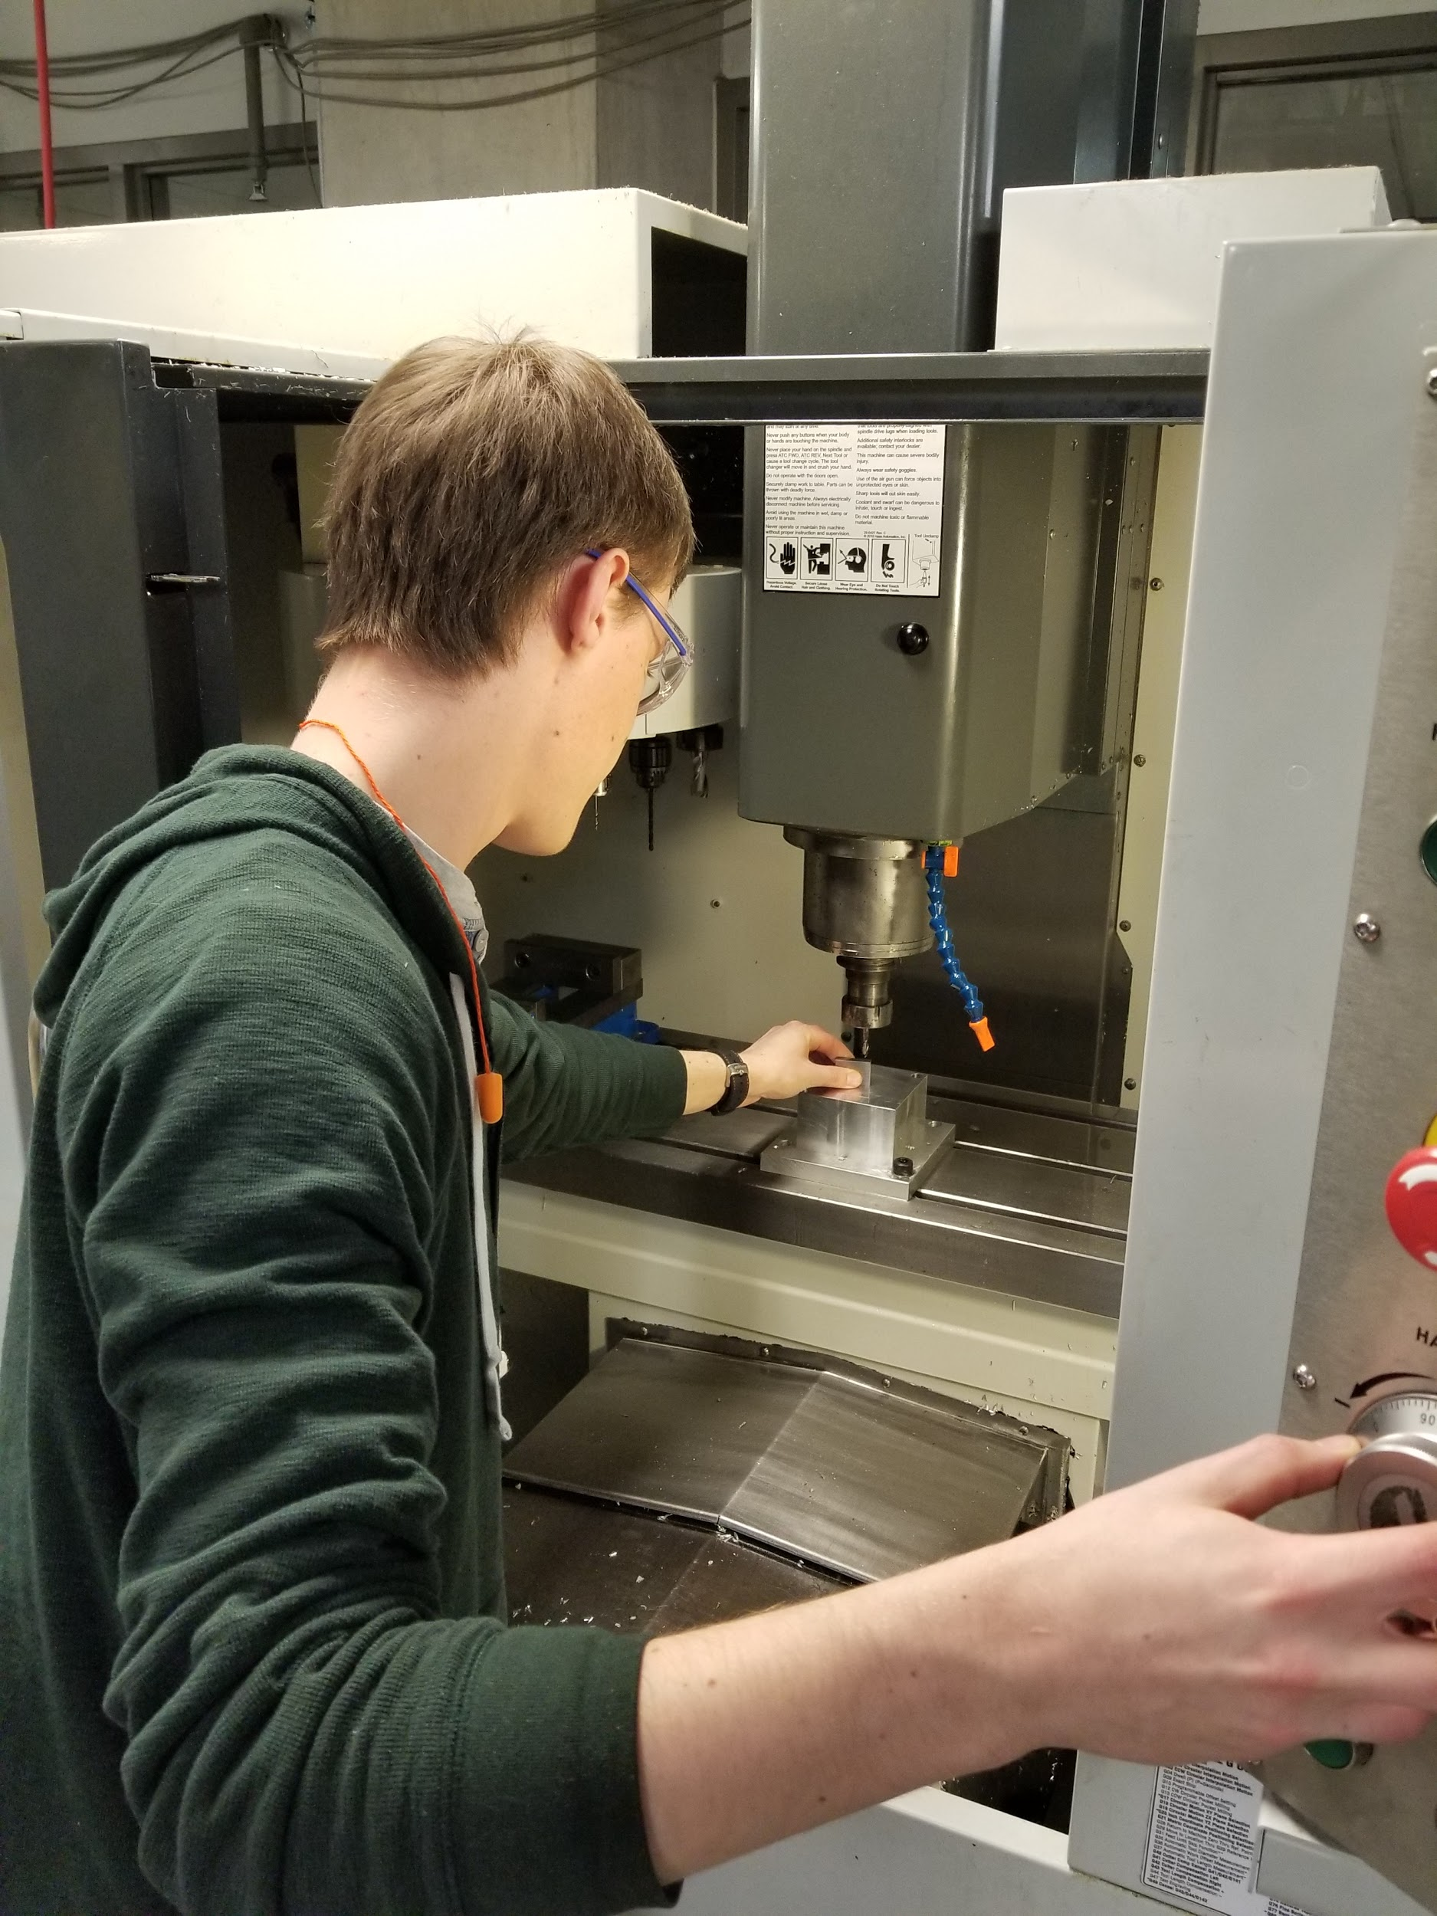
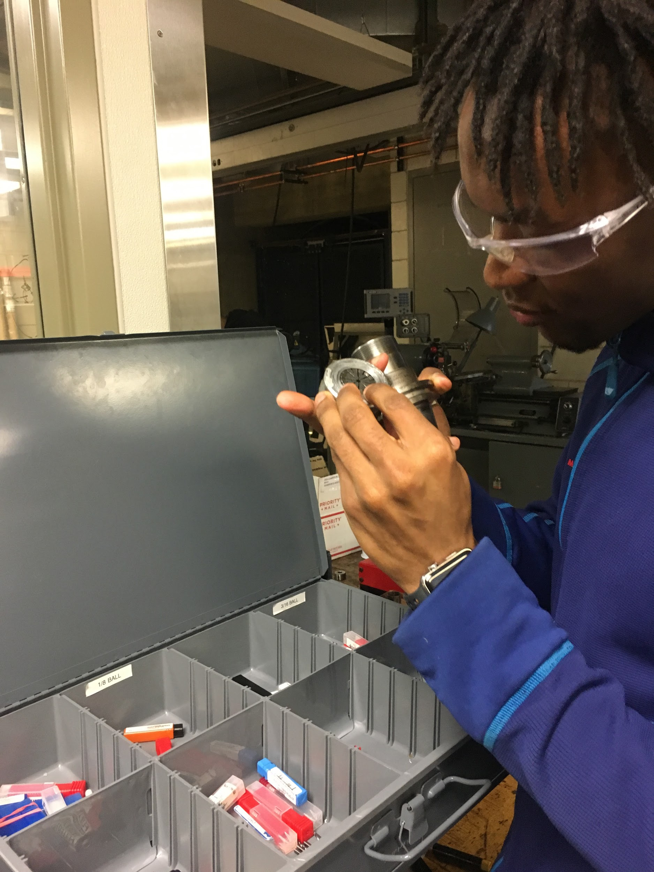
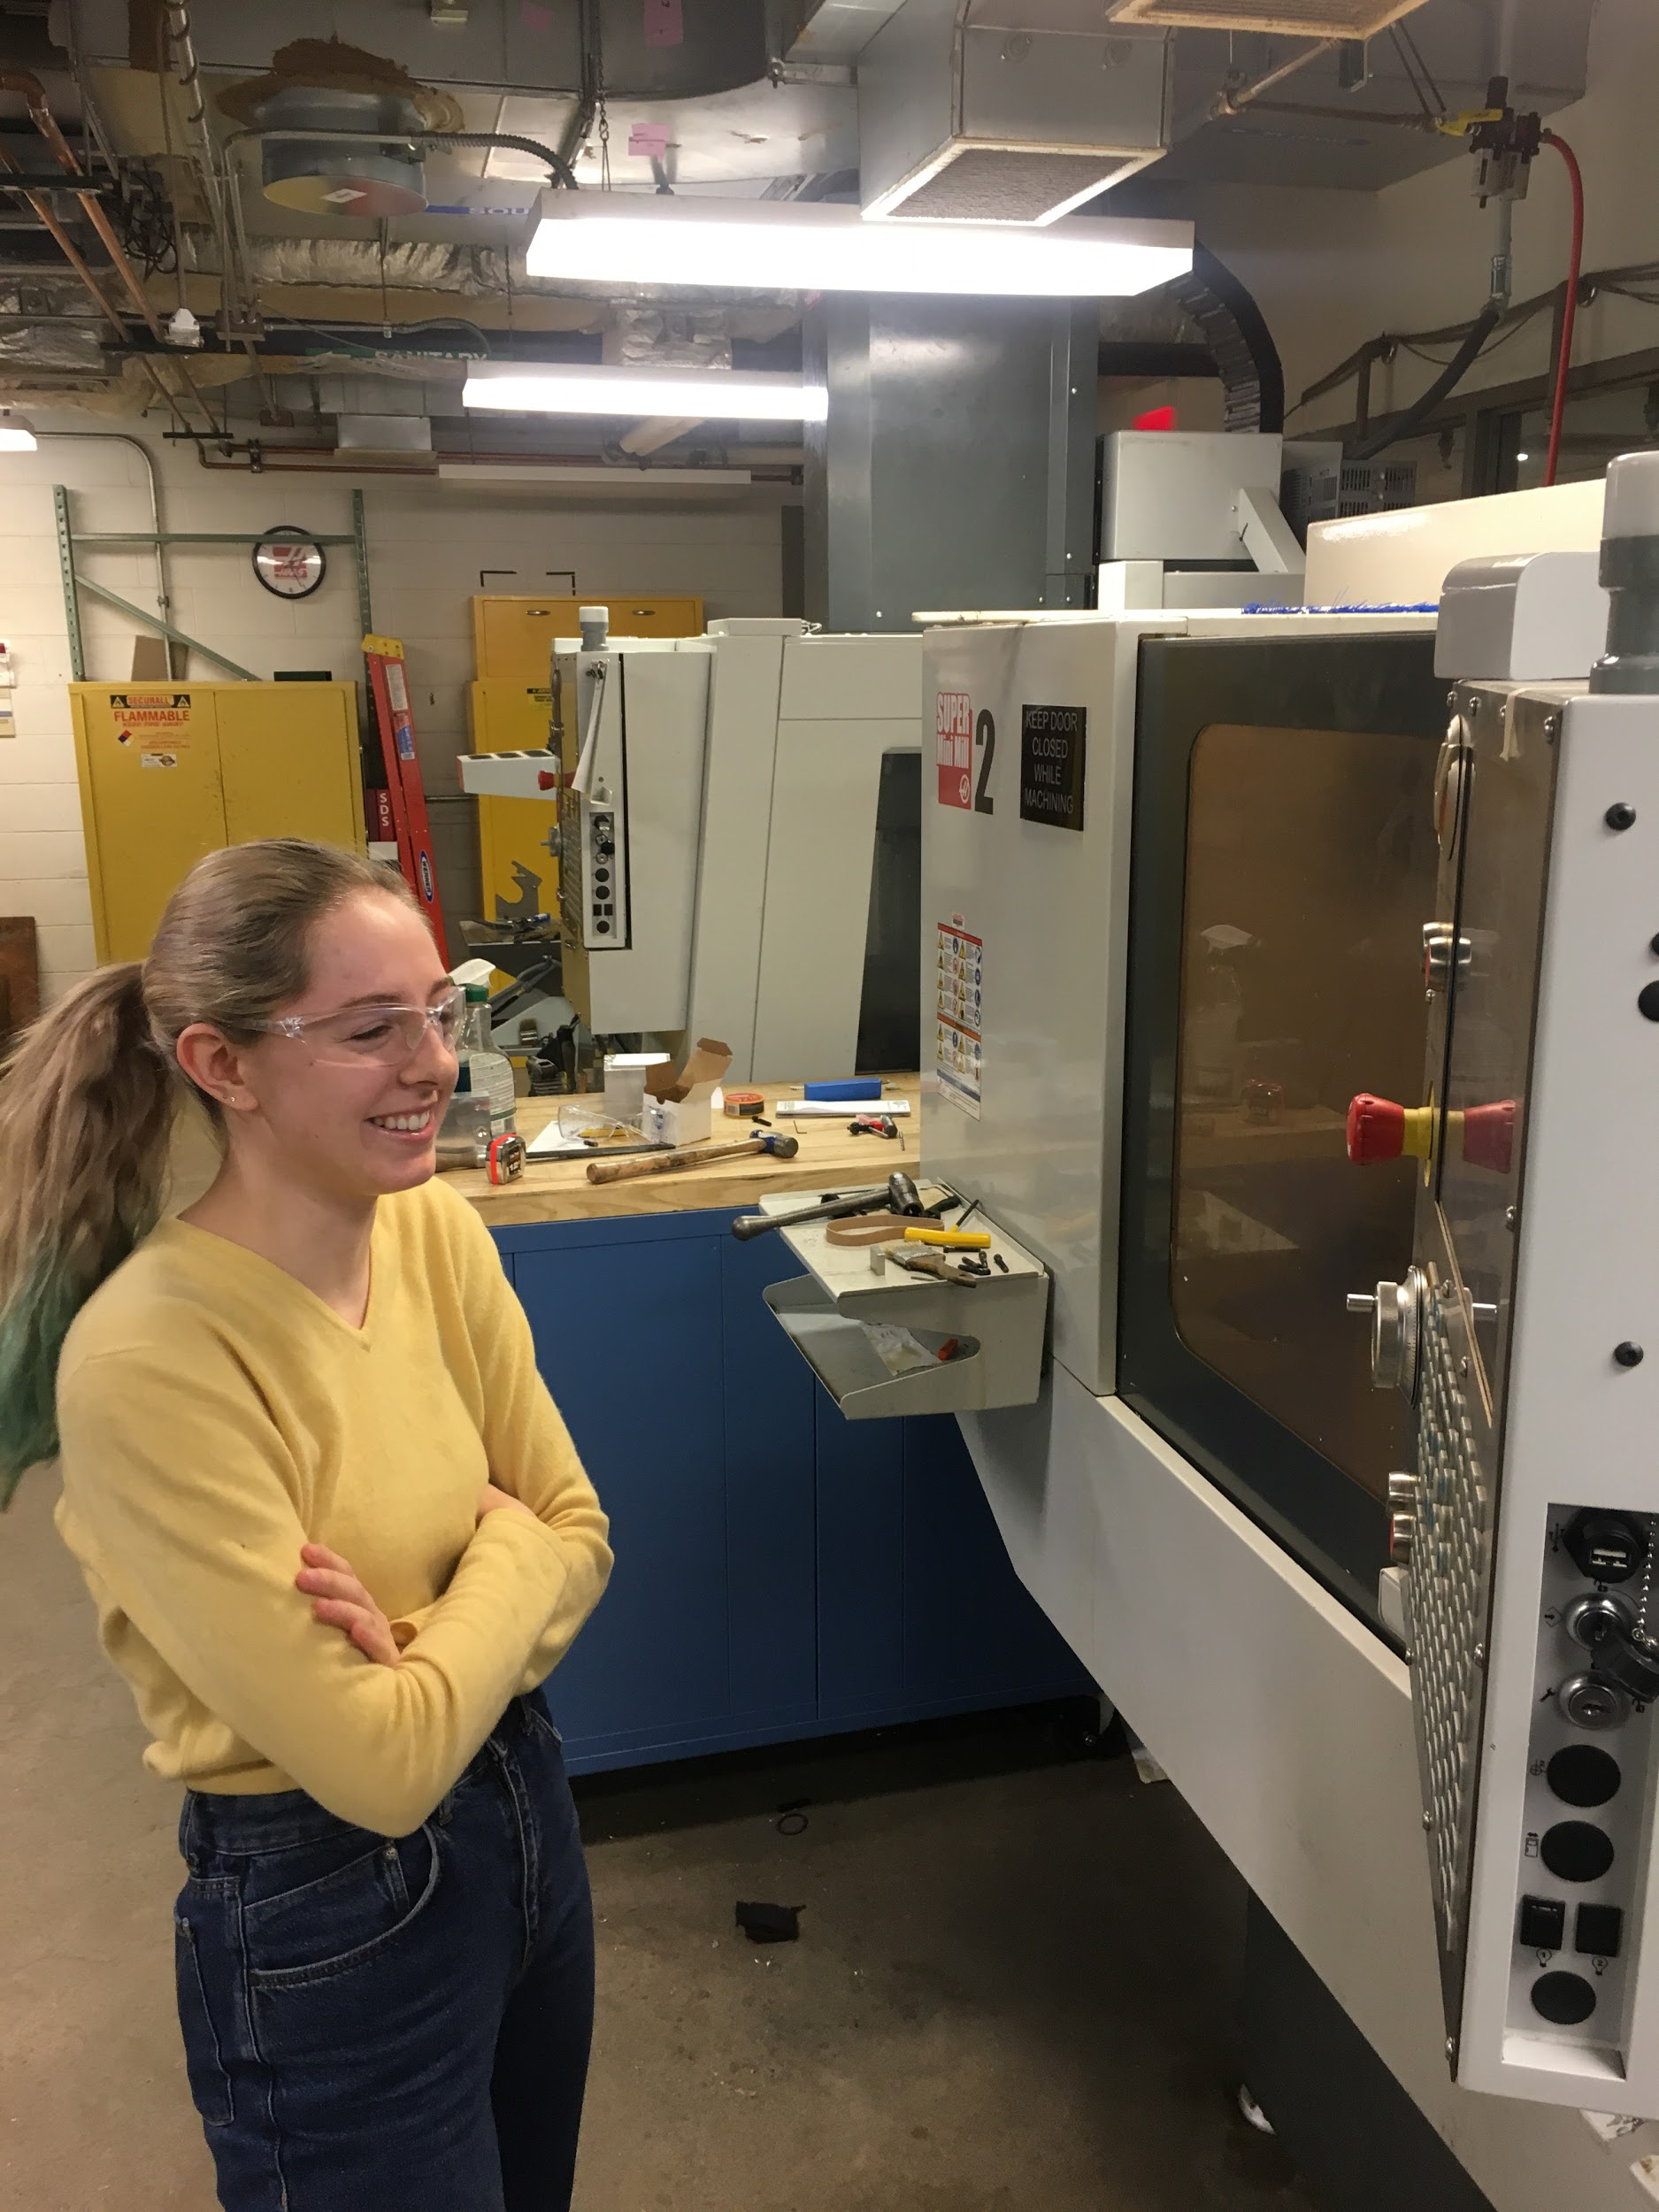
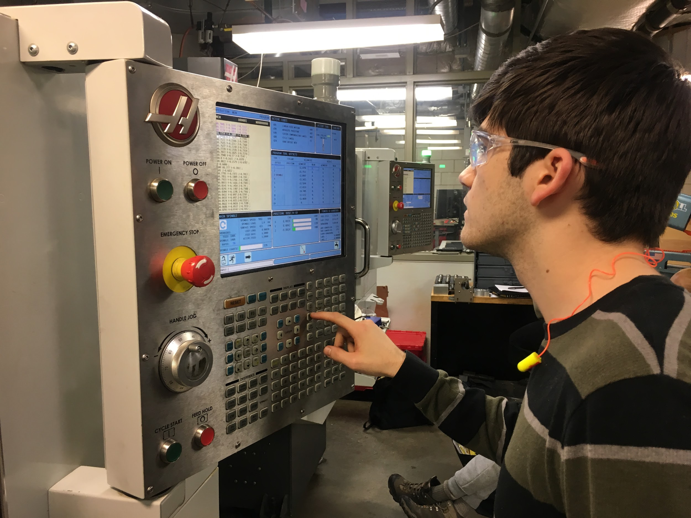
Manufacturing - CNC Milling
Notes:
Correct tools in holder
Feeds and speeds
Wanted surface finish 3 hours

Slide 9
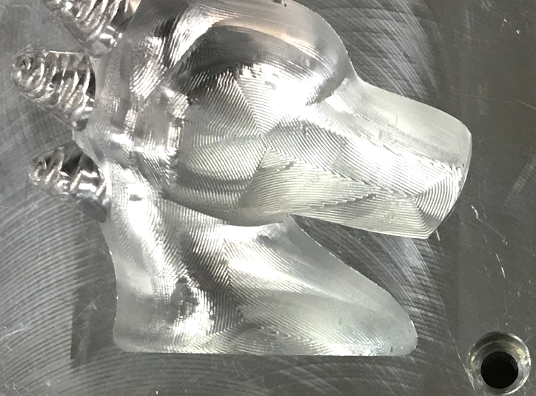
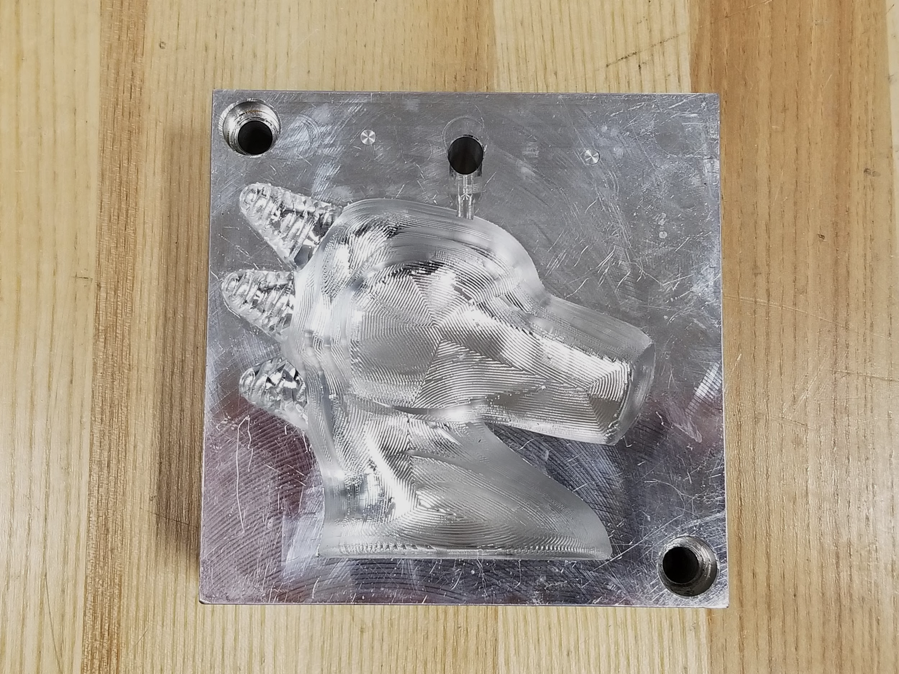
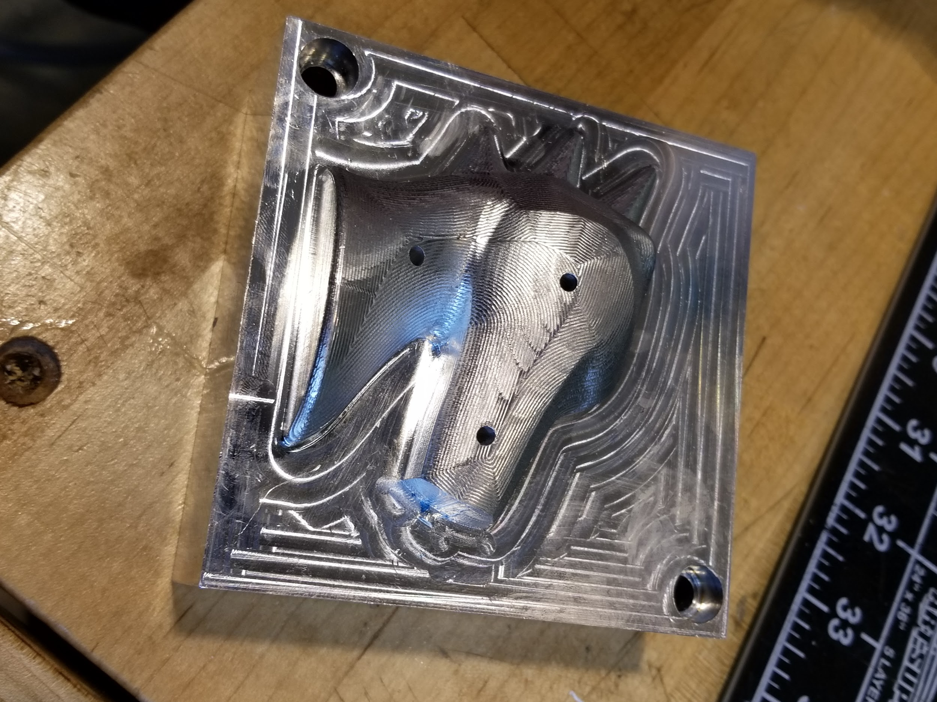
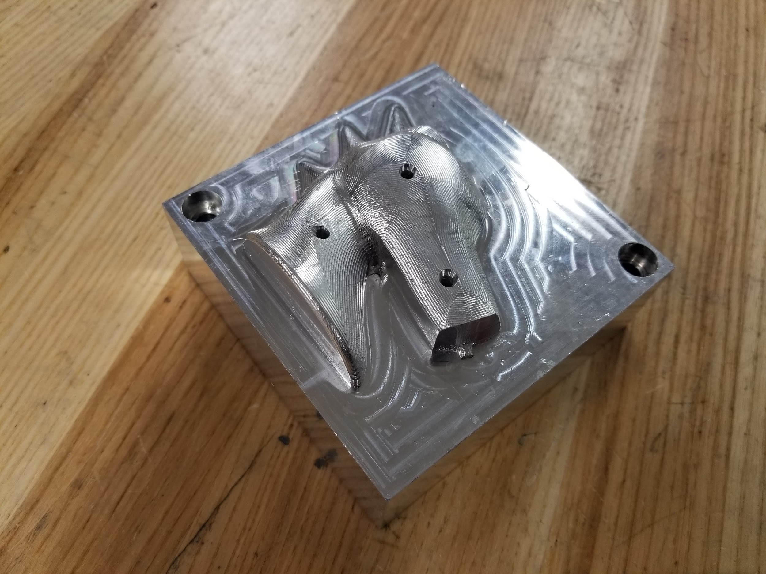
Manufacturing - Mold Revisions
Left Cavity
Adjust bottom fillet
CNC Program
Right Core
Deepen pin holes
Countersink for rigidity
Manual Mill

Slide 10
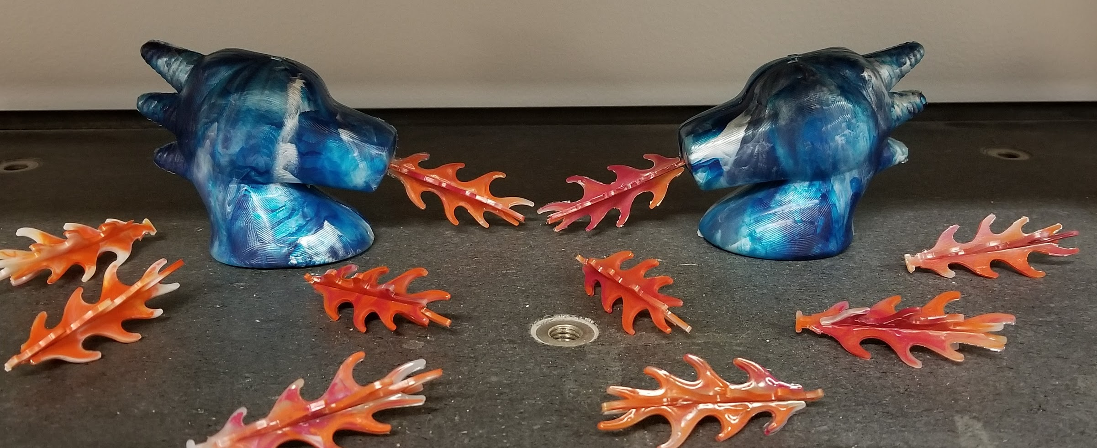

Final Products
Notes:
Show molds and produced parts to judges
Assemble in front of judges

Slide 11
Measurement Study
Average Deviation from Nominal Dimension
 | Flame Length | Left Thickness | Right Thickness
Average (in.) | 2.321 | .1183 | .1039
Nominal (in.) | 2.3511 | .1 | .1
Deviation (in.) | -.0301 | .0183 | .0039
Deviation (%) | 1.27 | 18.3 | 3.9
Causes |  | Additional Manufacturing to fix fillet
No. | Flame Length (in.) | Left Base Thick (in.) | Right Base Thick (in.)
1 | 2.35 | 0.118 | 0.103
2 | 2.3 | 0.116 | 0.104
3 | 2.32 | 0.116 | 0.104
4 | 2.35 | 0.119 | 0.106
5 | 2.31 | 0.125 | 0.103
6 | 2.31 | 0.122 | 0.103
7 | 2.3 | 0.115 | 0.105
8 | 2.32 | 0.113 | 0.104
9 | 2.3 | 0.12 | 0.103
10 | 2.35 | 0.118 | 0.107

Slide 12
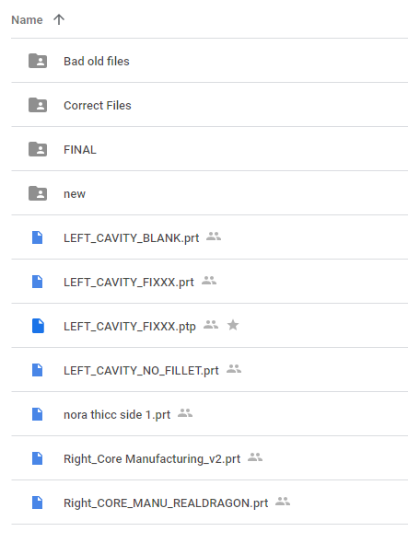
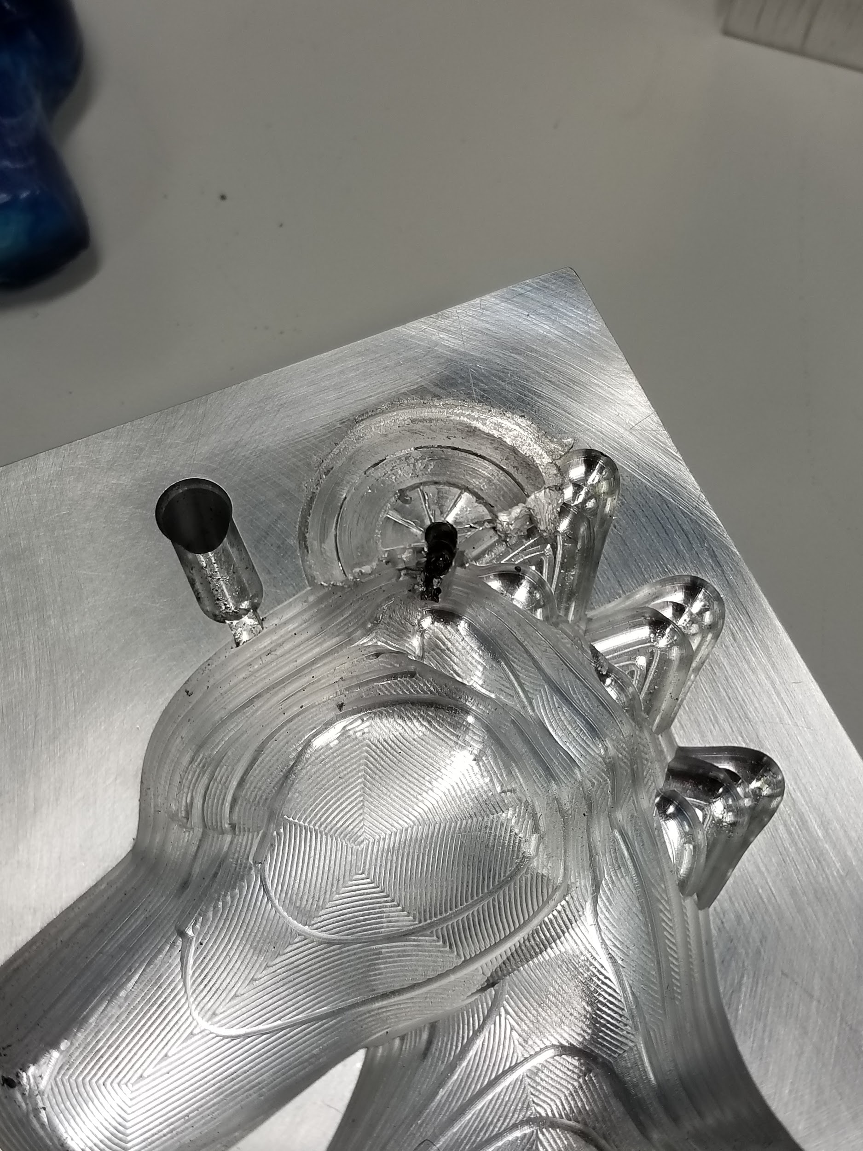
Things We Learned
Time and file management
Account for part shrinkage
Pin design
Always peck drill for holes
Double check tool and origin offsets

Slide 13
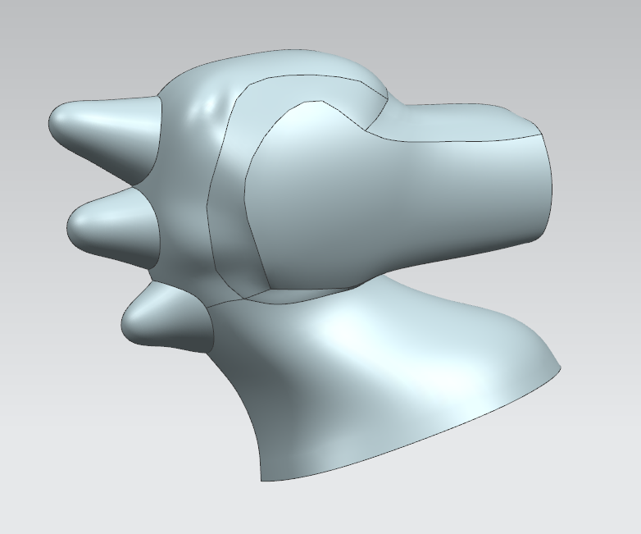
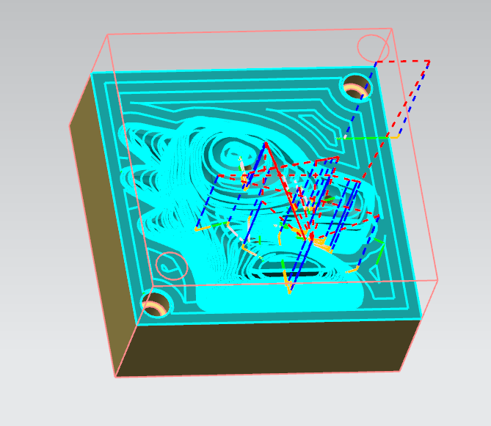
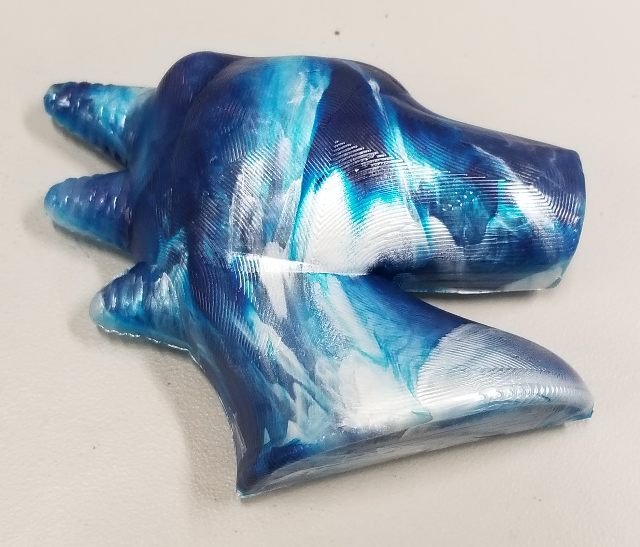
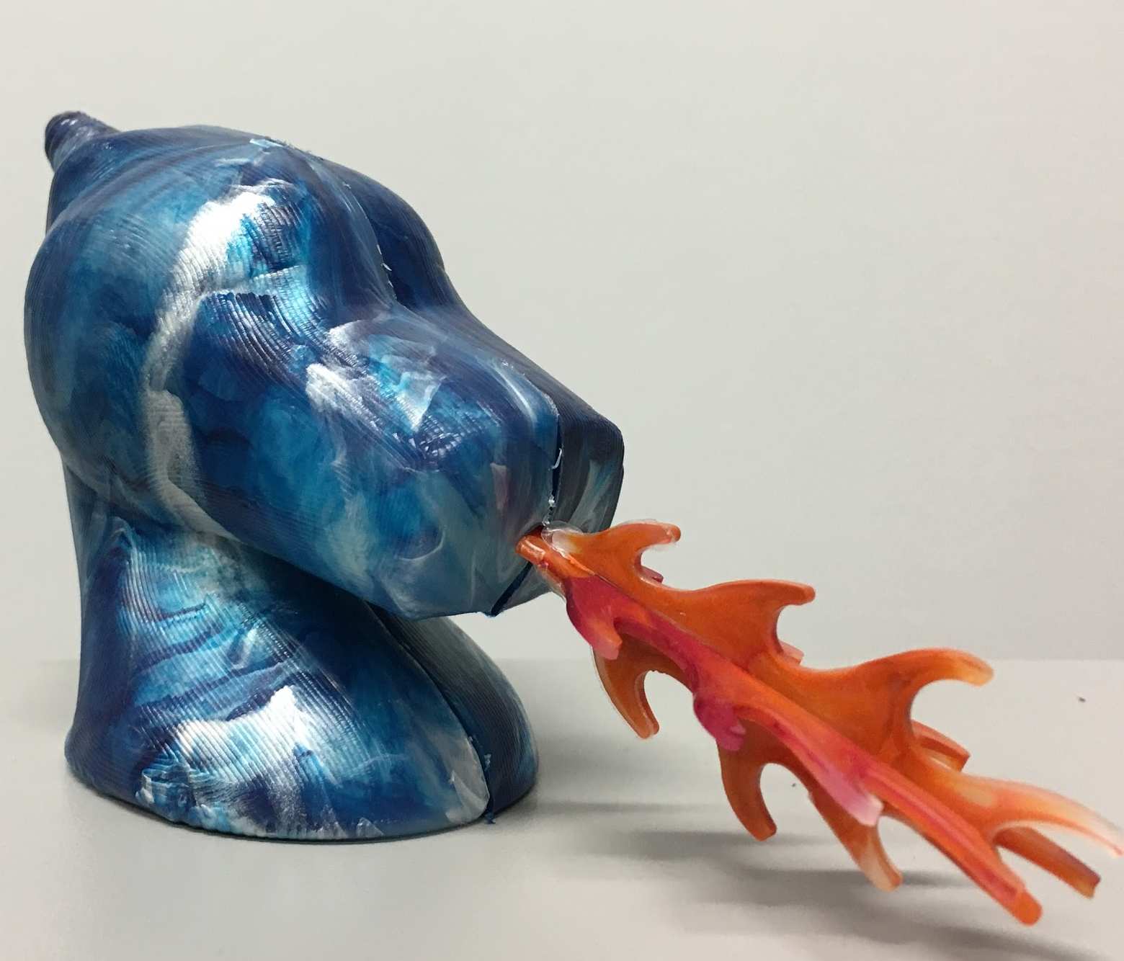
Questions?
Notes:
Pics of drawing, sketch, cad, molds, parts

